Slide 1

Sensors Project Gesture Control Using PIR Integrated Sensor To Help People In Crisis
Done By :
Abijith Pradeep –CB.EN.U4AIE19002
Rohith. G –CB.EN.U4AIE19026
KAUSHIK. M –CB.EN.U4AIE19036
Tarun Sanjeev. S –CB.EN.U4AIE19064

Slide 2
AIM
The prime motive of this project is to create a gesture controlled drone for emergency circumstances using an integrated PIR sensor. The drone also has a temperature sensor – useful in the case of fire accidents and ultrasonic sensors for its movement. Buzzer and LEDs are used for audible and visual alerts respectively.

Slide 3
COMPONENTS AND SOFTWARE
Software
Hardware
TINKERCAD ACCESS
2 – Arduino Uno Boards
2 – mini breadboards
3 – LED lights – Red, Yellow and Green
TMP-36 Temperature Sensor
Ultrasonic Sensor
PIR Sensor
Servo Motor
Buzzer
3 – 1 k ohms resistor,
Jumper Wires

Slide 4
SENSORS USED
PIR Sensor
TMP-36 Temperature Sensor
Ultrasonic Sensor

Slide 5
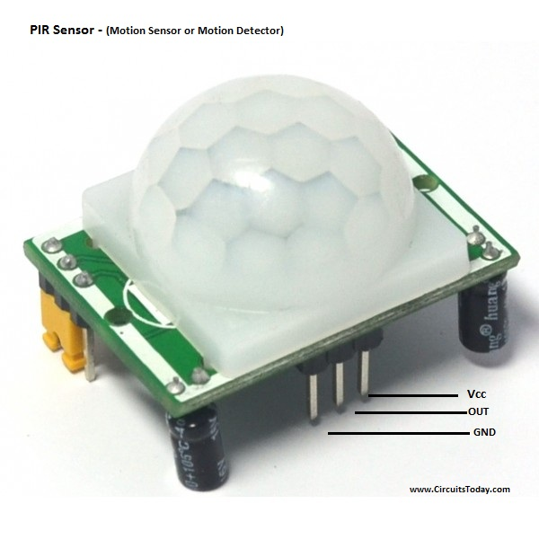
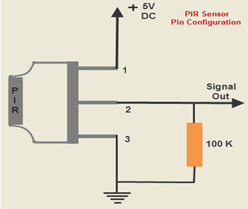
PIR
Passive Infra Red. It detects radiations and converts them to electric charge

Slide 6
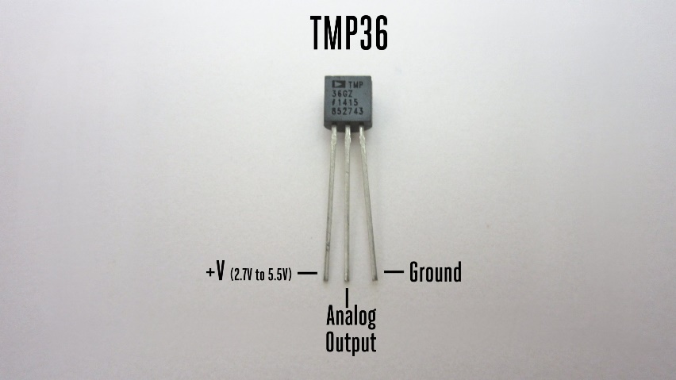
TMP-36 Temperature sensor
The TMP-36 sensor temperature range is -40 degree Centigrade to 125 degree Centigrade.

Slide 7
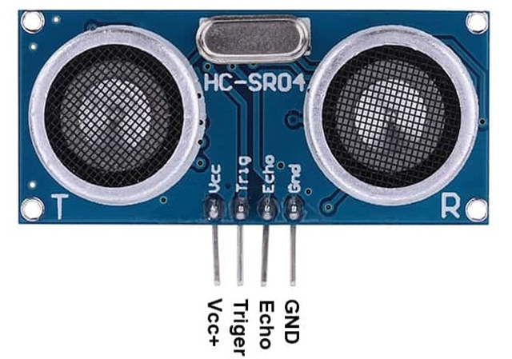
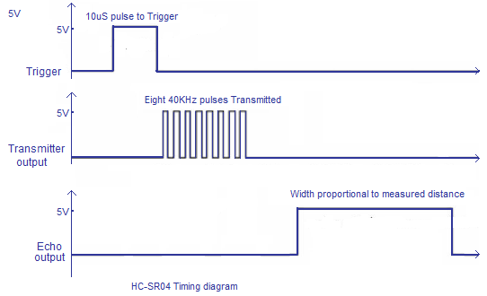
Ultrasonic Sensor
Distance Calculated will be =17050*Time

Slide 8
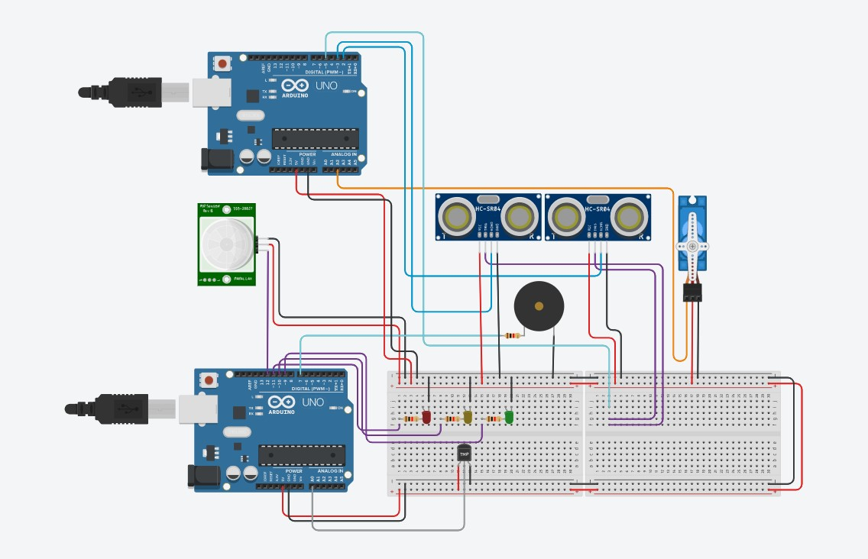
CIRCUIT DESIGN

Slide 9
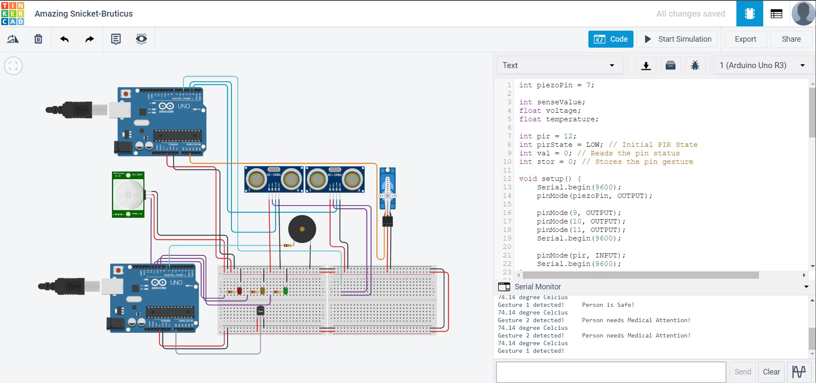

Slide 10
PROCEDURE
On the Tinkercad platform, obtain the following materials – 2 Arduino Uno R3 boards, 2 mini Breadboards, 3 leds, 3 - 1 kOhms resistors, TMP-36 temperature sensor, Ultrasonic Sensor, Servo motor, PIR Sensor and Buzzer.
Connect these materials as shown in the circuit diagram.
The TMP-36 sensor has its output connected to A0 analog pin.
The PIR sensor has its signal pin connected to digital pin 9.
From the digital pins 5,6,7 make a connection to the three led bulbs.
From the digital pin 2, make a connection to the buzzer.
Make connections for the ultrasonic sensor.

Slide 11
3. Use the code mentioned for the simulation.
4. Enter start simulation button to virtually give power supply to the Arduino Uno.
5. Now, change the positions present in front of the PIR sensor, by clicking on the sensor.
6. Also, change the temperature around the sensor.

Slide 12
ARDUINO CODE: OPERATING THE DRONE
#include <Servo.h>
int trigPin = 5;
int echoPin1 = 3;
int echoPin2 = 2;
long duration, cm1, cm2;
Servo myservo;
int pos = 0;
void setup()
{
Serial.begin(9600);
pinMode(trigPin, OUTPUT);
pinMode(echoPin1, INPUT);
pinMode(echoPin2, INPUT);
myservo.attach(A2);
}

Slide 13
void loop()
{
// Code for UltraSonic Sensor 1
digitalWrite(trigPin, LOW);
delayMicroseconds(5);
digitalWrite(trigPin, HIGH);
delayMicroseconds(10);
digitalWrite(trigPin, LOW);
pinMode(echoPin1, INPUT);
duration = pulseIn(echoPin1, HIGH);
cm1 = duration * 17050;
delay(100);
// Code for UltraSonic Sensor 2
digitalWrite(trigPin, LOW);
delayMicroseconds(5);
digitalWrite(trigPin, HIGH);
delayMicroseconds(10);
digitalWrite(trigPin, LOW);
pinMode(echoPin2, INPUT);
duration = pulseIn(echoPin2, HIGH);
cm2 = duration * 17050;
delay(100);

Slide 14
// Code for rotating the Servo Motor
for (pos = 0; pos <= 180; pos += 1) {
myservo.write(pos);
delay(10);
}
for (pos = 180; pos >= 0; pos -= 1) {
myservo.write(pos);
delay(10);
}
}

Slide 15
ARDUINO CODE: PIR INTEGRATED SENSOR
int piezoPin = 7;
int senseValue;
float voltage;
float temperature;
int pir = 12;
int pirState = LOW; // Initial PIR State
int val = 0; // Reads the pin status
int stor = 0; // Stores the pin gesture
void setup() {
Serial.begin(9600);
pinMode(piezoPin, OUTPUT);
pinMode(9, OUTPUT);
pinMode(10, OUTPUT);
pinMode(11, OUTPUT);
Serial.begin(9600);
pinMode(pir, INPUT);
Serial.begin(9600);
}

Slide 16
//LED Temperature Indication
if (temperature <=10 || temperature >=100) {
digitalWrite(11, HIGH);
delay(500);
digitalWrite(11, LOW);
delay(200);
}
else if (temperature >=50 && temperature <100) {
digitalWrite(10, HIGH);
delay(500);
digitalWrite(10, LOW);
delay(200);
}
else {
digitalWrite(9, HIGH);
delay(500);
digitalWrite(9, LOW);
delay(200);
}
void loop() {
//Temperature Sensor
senseValue = analogRead(A0);
voltage = ((senseValue/1023.0)*5.0);
temperature = (voltage-0.5)*100;
Serial.print(temperature);
Serial.print(" degree Celcius");
Serial.println();
delay(100);

Slide 17
//PIR Sensor Code for Gesture Control
// Code for varied buzz frequencies from buzzer
// in different conditions
val = digitalRead(pir);
if (val == LOW){
Serial.print("Gesture 1 detected!");
tone(piezoPin, 5000);
delay(250);
noTone(piezoPin);
delay(250);
Serial.print("\t"); Serial.print("Person is Safe!");
Serial.println();
}
else if (val == HIGH){
Serial.print("Gesture 2 detected!");
tone(piezoPin, 1000);
delay(250);
noTone(piezoPin);
delay(250);
Serial.print("\t"); Serial.print("Person needs Medical Attention!");
Serial.println();
}
}

Slide 18
Analysis in Four Parts
Ultrasonic Sensor
TMP-36
PIR
Buzzer

Slide 19
PIR and BUZZER
The PIR sensor gives out the digital values of 0’s and 1’s based on the movement of the marked position.
Therefore upon movement, the PIR sensor gives the value of 1.
There are two thresholds set up – input is low or high, i.e, 0 or 1.
The buzzer sound frequency changes with corresponding gesture and thus the person controlling the drone can understand or pass through a message in case of help.

Slide 20
ULTRASONIC SENSOR and TMP-36
The ultrasonic sensor enables the drone’s movement.
If an obstacle is close to the drone, the servo motors would slow down and when an object is far off from the drone, the drone motors speed up.
It is the forward and the sideward movements of the drone which is being monitored.
The temperature sensor on the other hand is used to sense the temperature.
If the temperature is very high, the red light glows up and if its moderate then the yellow light glows up.
When the temperature is low, the green light glows up.
These LEDs give the visual alert for the temperature. The application of the temperature sensor is that, this drone can be used in case of fire accidents to aid the people to evacuate the hostages provided, the drone is made of good quality to sustain the heat.

Slide 21
APPLICATIONS
The drone can be used in following occasions
Fire Accidents
Natural Calamities – Earthquake, Tsunami, Flood, etc.
To Secure Hostages from Terrorist Attacks.

